Slide 1


EE 305 project
Group 9

Slide 2
Group Members:
Harshitha Budati 200002022
K Sneha 200002041
Pavani Oruganti 200002057
Sarvani V S 200002068
Kirtika Zanzan 200002085

Slide 3
Problem Statement
Consider a plane wave (having angular frequency of w rad/sec and phase constant of 𝛃 rad/m) propagating along a transmission line and terminated by a load impedance ZL. The transmission line has a characteristic impedance of Zo (=Ro + jXo) and length of l. Plot the input impedance Zi of the transmission line for different values of the load impedance ZL (=RL + jXL).
Note:
the parameter l should be considered as input in terms of 𝛌. The parameter values 𝛃, w, l, R0, X0, RL, XL will be provided from user-end.

Slide 4
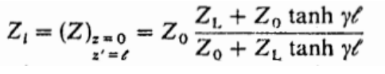
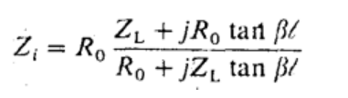
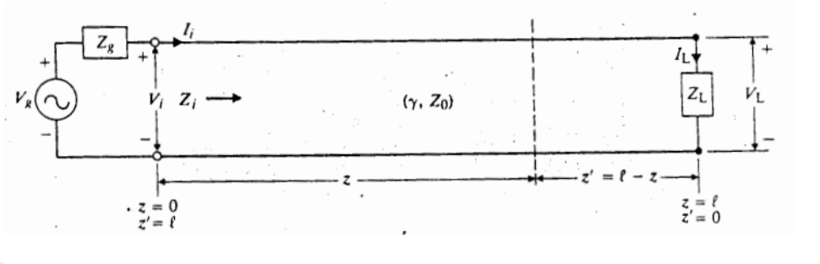
THEORY
The propagation constant for a TEM wave is
Ɣ = 𝝰+ j 𝛃
Where 𝝰 is attenuation factor and 𝛃 is phase shift constant.
The formula for the input impedance Zi of a lossless line of length l terminated in ZL
Equation (I)
In most cases transmission-line segments can be considered lossless. i.e. 𝝰 = 0
Hence, Ɣ = j𝛃, Z0 = R0, and tanh Ɣl = tanh (j𝛃l) = j tan 𝛃l
The equation (I) becomes
Equation (II)

Slide 5
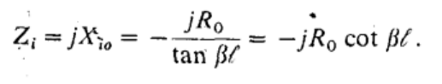
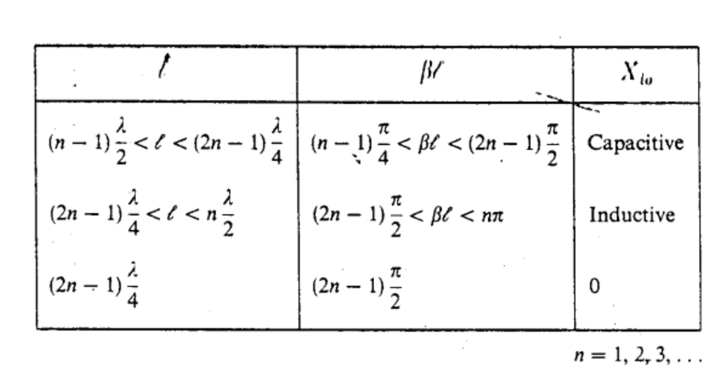
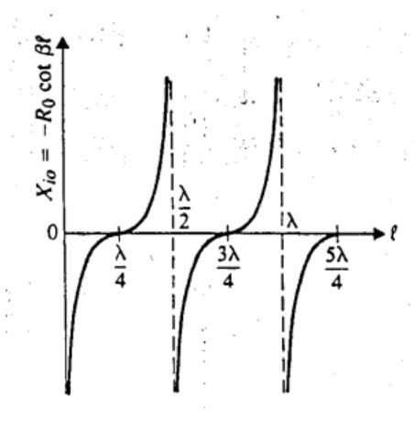
We now consider several important special cases under lossless conditions:
1. Open-circuit termination (ZL →∞)
We have, from Eq. (II),
Equation (III)
Above equation shows that the input impedance of an open-circuited lossless line is purely reactive. The line can, however, be either capacitive or inductive because the function cot 𝛃l can be either positive or negative, depending on the value of 𝛃l(=2𝞹l/𝛌).
Input reactance of open-circuited transmission line

Slide 6
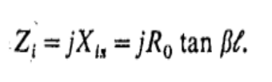
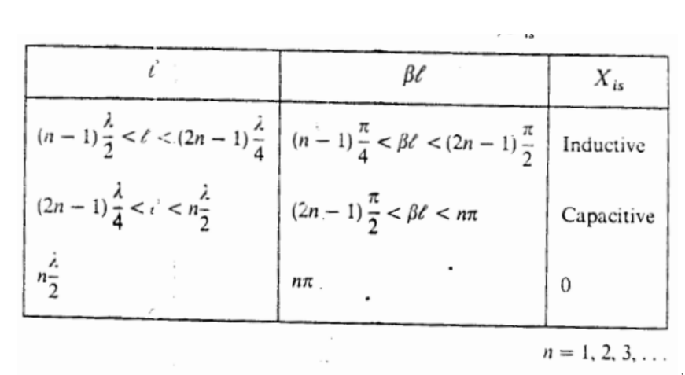
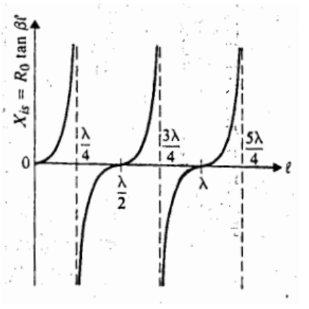
2. Short circuit (ZL=0)
We have, from Eq. (II),
Equation (IV)
Since tan 𝛃l can range from -∞ to +∞, the input impedance of a short-circuited lossless line can also be either purely inductive or purely capacitive, depending on the value of 𝛃l
Input reactance of short-circuited transmission line

Slide 7
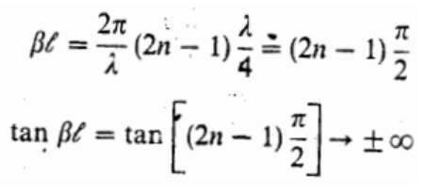
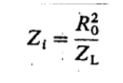
3. Quarter-wave sections (l = 𝞴/4, 𝛃l= 𝞹/2)
When the length of a line is an odd multiple of 𝞴 /4, l = (2n-1)𝞴/4, (n = 1,2,3, . .)
And eq(I) becomes
Quarter-wave line
Hence, a quarter-wave lossless line transforms the load impedance to the input terminals as its inverse multiplied by the square of the characteristic resistance; it is often referred to as a quarter-wave transformer.

Slide 8
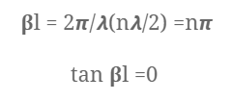
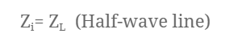
4. Half-wave sections (l = 𝞴/2, 𝛃l= 𝞹)
When the length of a line is an integral multiple of 𝞴/2, l = n𝞴/2 (n = 1, 2, 3, . . .),
Thus, eq(I) reduces to
a half-wave lossless line transfers the load impedance to the input terminals without change.
We get linear graphs for Zi vs Zl plot in this case.

Slide 9
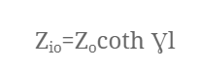
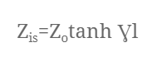
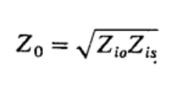
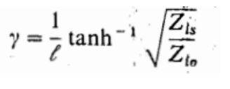
Whereas when the transmission line segments are lossy i.e  ≠ 0,
1. Open circuited line, (ZL →∞)
2. Short circuited line, (ZL = 0)
From above two equations,

Slide 10

In short circuited lossy transmission line (ZL = 0),
1. Quarter-wave section ($l=(2n−1) λ/4)$
$Z_{is}≈\frac{Z_{0}}{αL}$
2. Half-wave section ($l$ = λ/2)
$Z_{is}≈Z_{0}(αL)$

Slide 11
CODE WALK THROUGH

Slide 12
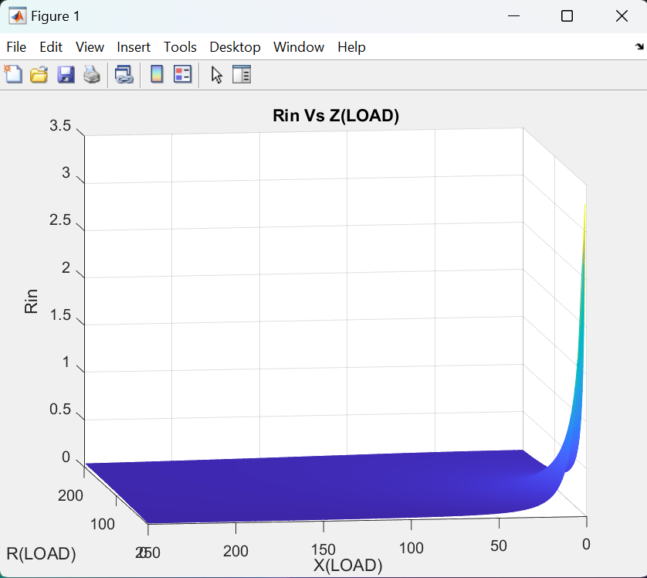
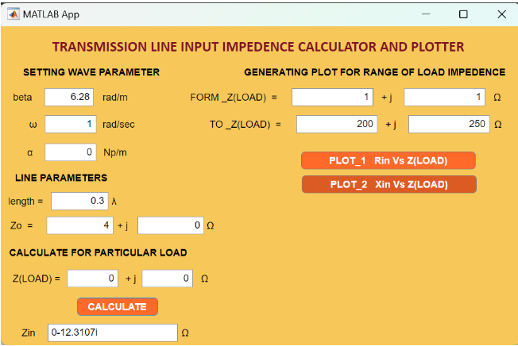
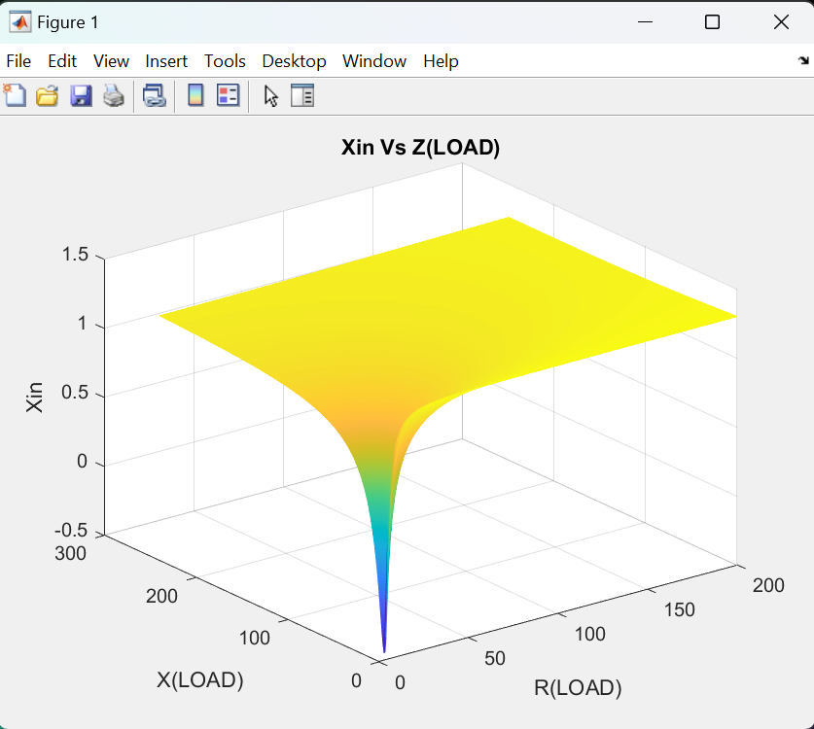
RESULTS
Lossless Case 𝝰 = 0:
1. Short circuit case (ZL=0)

Slide 13
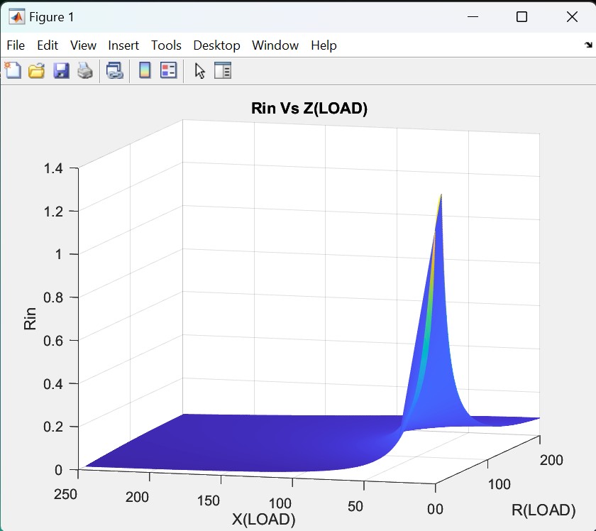
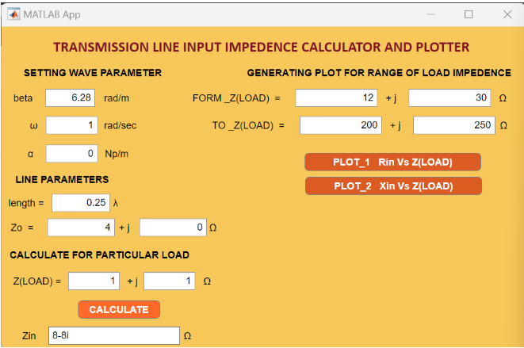
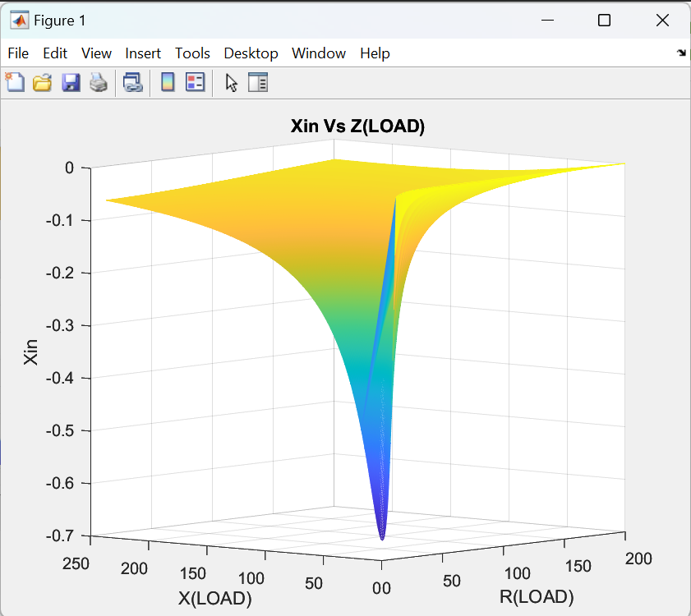
2. Quarter-wave sections (l = 𝞴/4, 𝛃l= 𝞹/2)

Slide 14
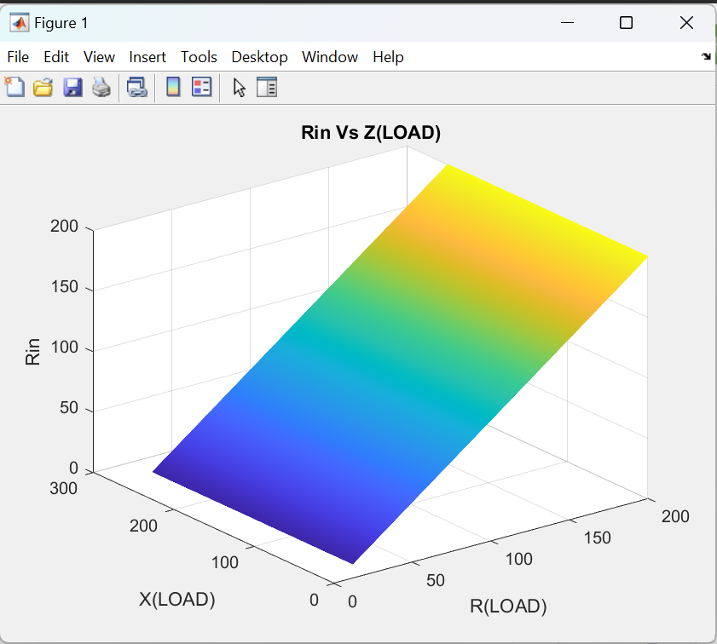
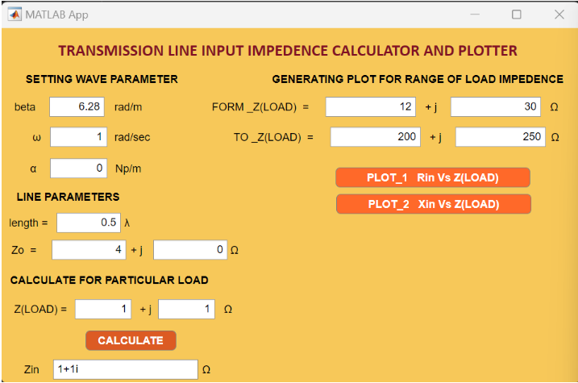
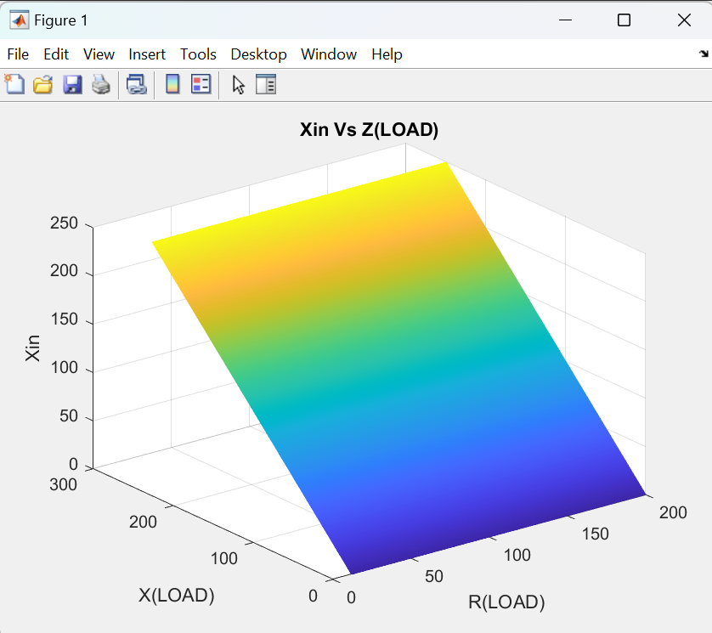
3. Half-wave sections (l = 𝞴/2, 𝛃l= 𝞹)

Slide 15
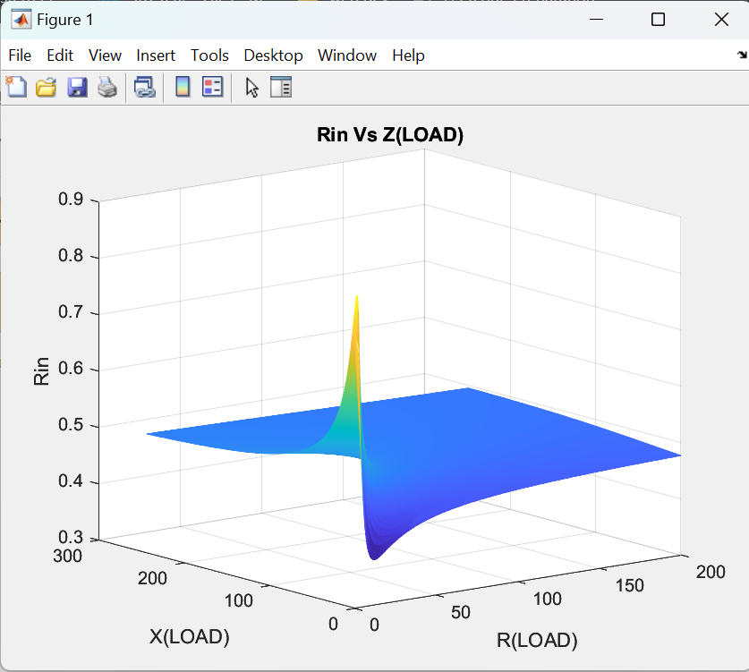
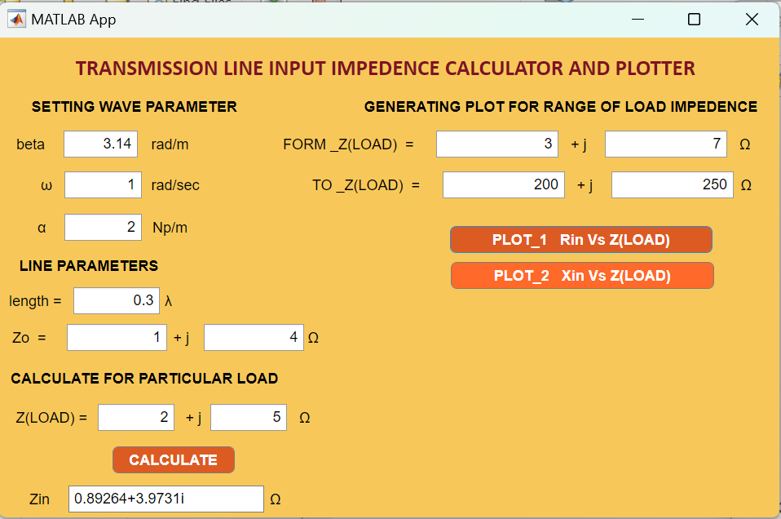
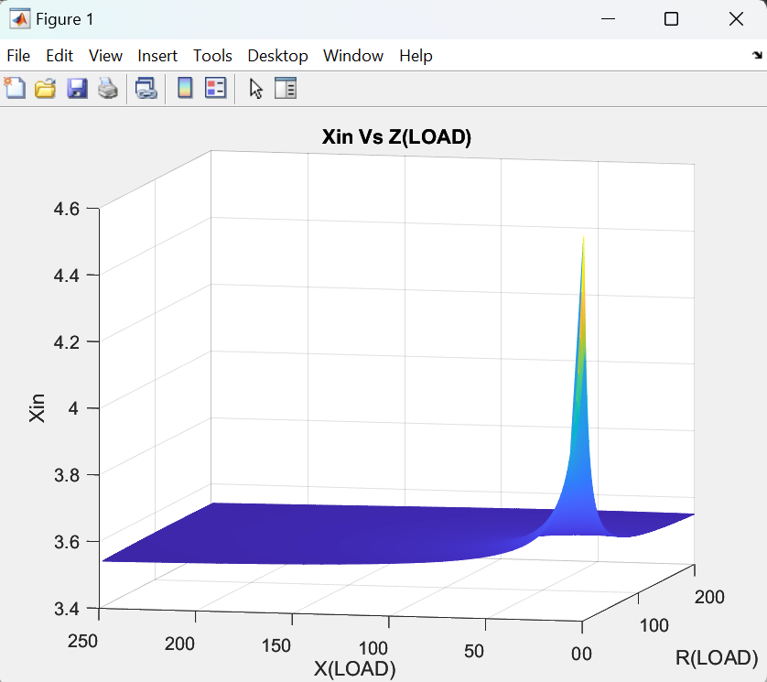
Lossy case ɑ≠0:

Slide 16
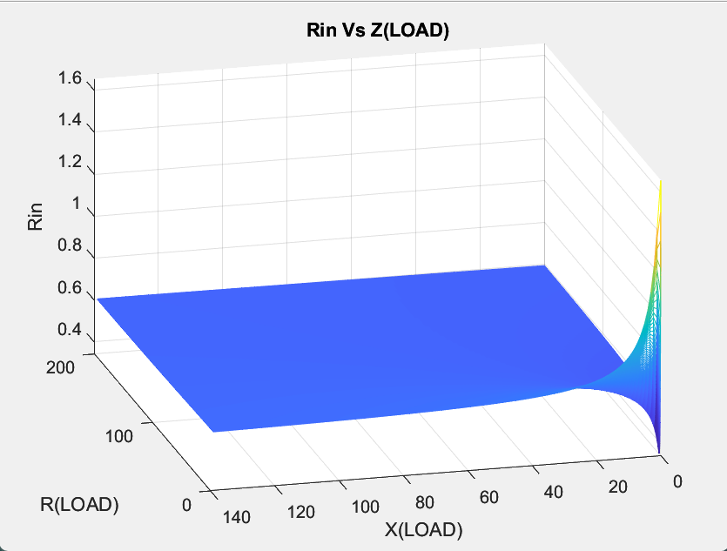
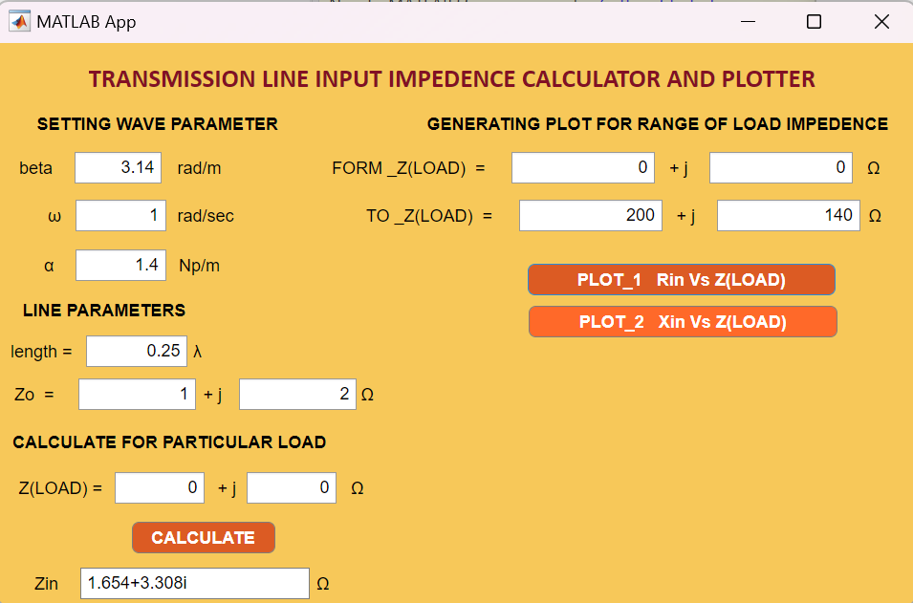
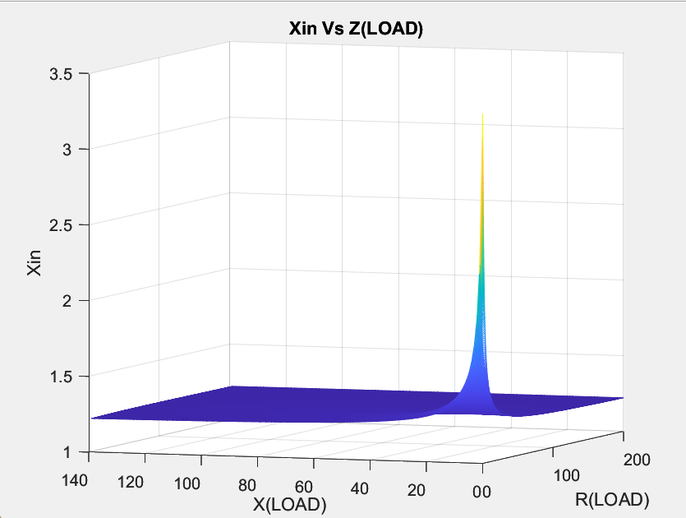
1.Short Circuit and Quarter-wave(ZL=0, l = 𝞴/4)

Slide 17
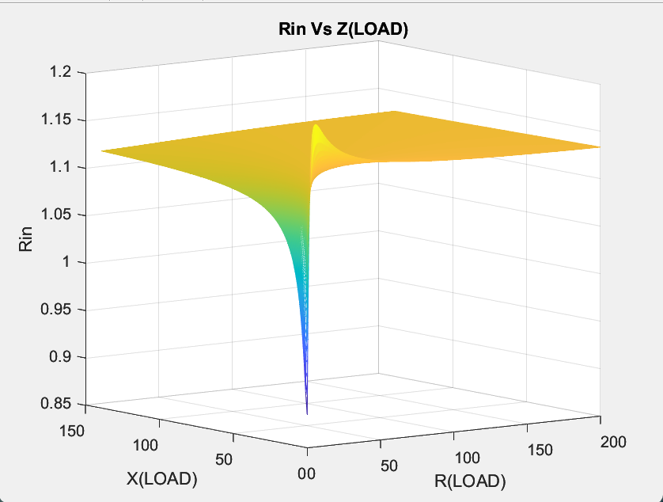

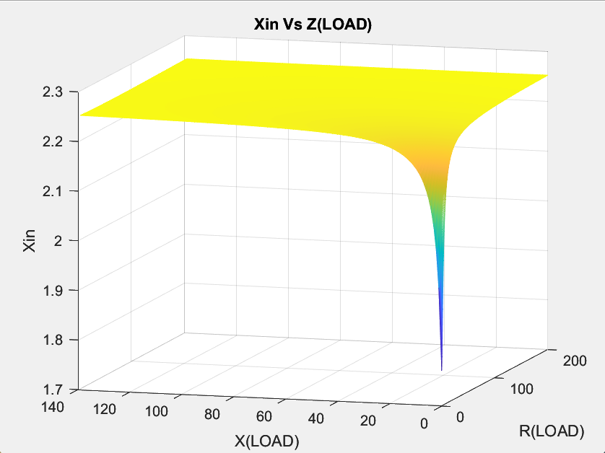
2.Short Circuit and Half-wave(ZL=0, l = 𝞴/4)

Slide 18
CONCLUSION
We’ve seen how transmission lines behave in different conditions such as lossless/lossy and also in different lengths of sections into consideration.
REFERENCES
1. Lecture Notes
2. David K. Cheng : Fields and elctromangnetics

Slide 19
THANK YOU

